Slide 1
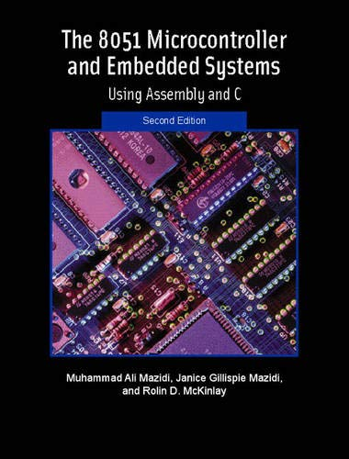
THE 8051
MICROCONTROLLER & Embedded Systems
Muhammad Ali Mazidi, Janice Mazidi
& Rolin McKinlay

Slide 2
8051 SERIAL PORT
PROGRAMMING
IN ASSEMBLY AND C
Chapter 10

Slide 3
Objectives
Upon completion of this chapter, you will be able to:
>> Contrast and compare serial versus parallel communication
>> List the advantages of serial communication over parallel
>> Explain serial communication protocol
>> Contrast synchronous versus asynchronous communication
>> Contrast half- versus full-duplex transmission
>> Explain the process of data framing
>> Describe data transfer rate and bps rate
>> Define the RS232 standard
>> Explain the use of the MAX232 and MAX233 chips
>> Interface the 8051 with an RS232 connector
>> Discuss the baud rate of the 8051
>> Describe serial communication features of the 8051
>> Program the 8051 serial port in Assembly and C
>> Program the second serial port of DS89C4x0 in Assembly and C

Slide 4
Objectives
Section 10.1, the basics of serial communication,
Section 10.2, 8051 interfacing to RS232 connectors via MAX232 line drivers,
Section 10.3, programming the second serial port of DS89C4x0

Slide 5
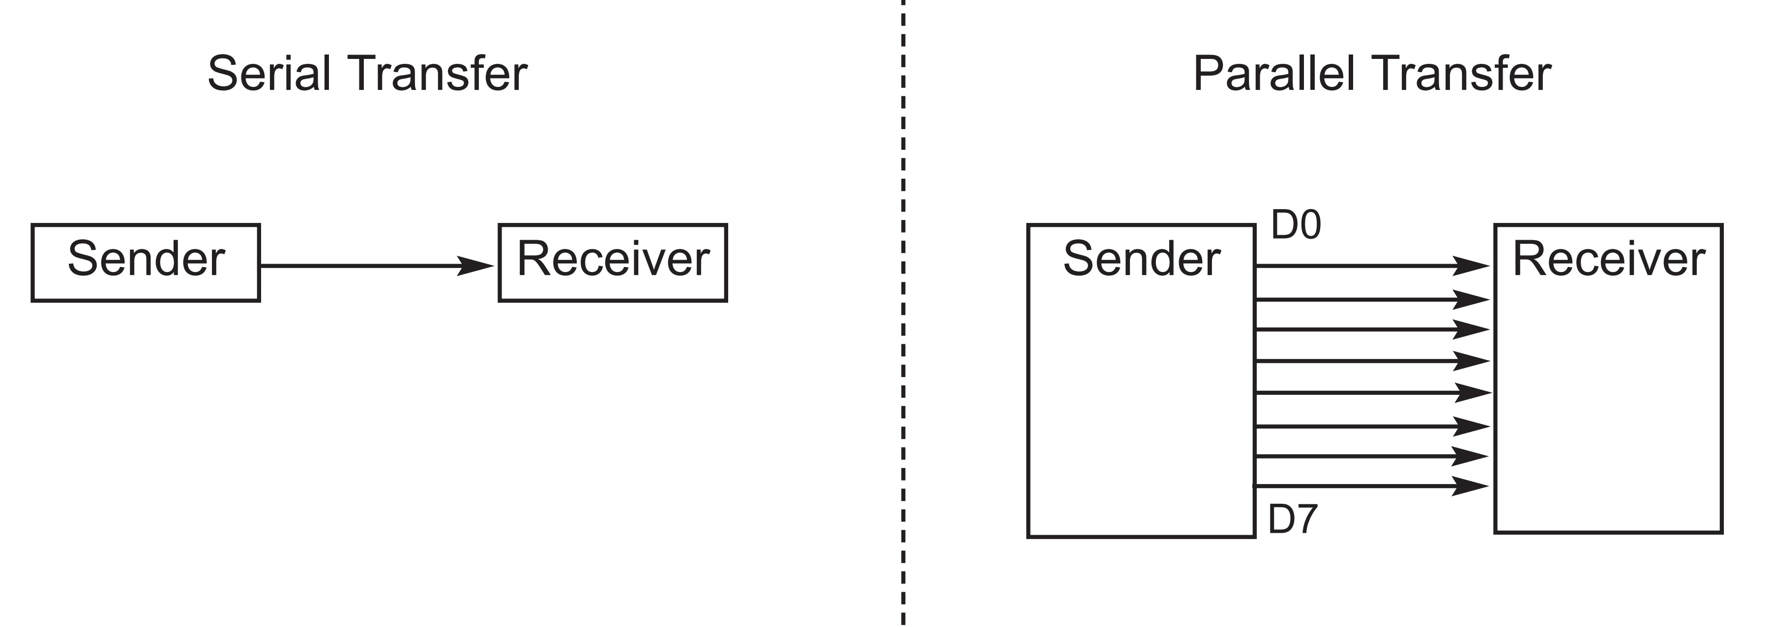
Figure 10-1. Serial versus Parallel Data Transfer

Slide 6
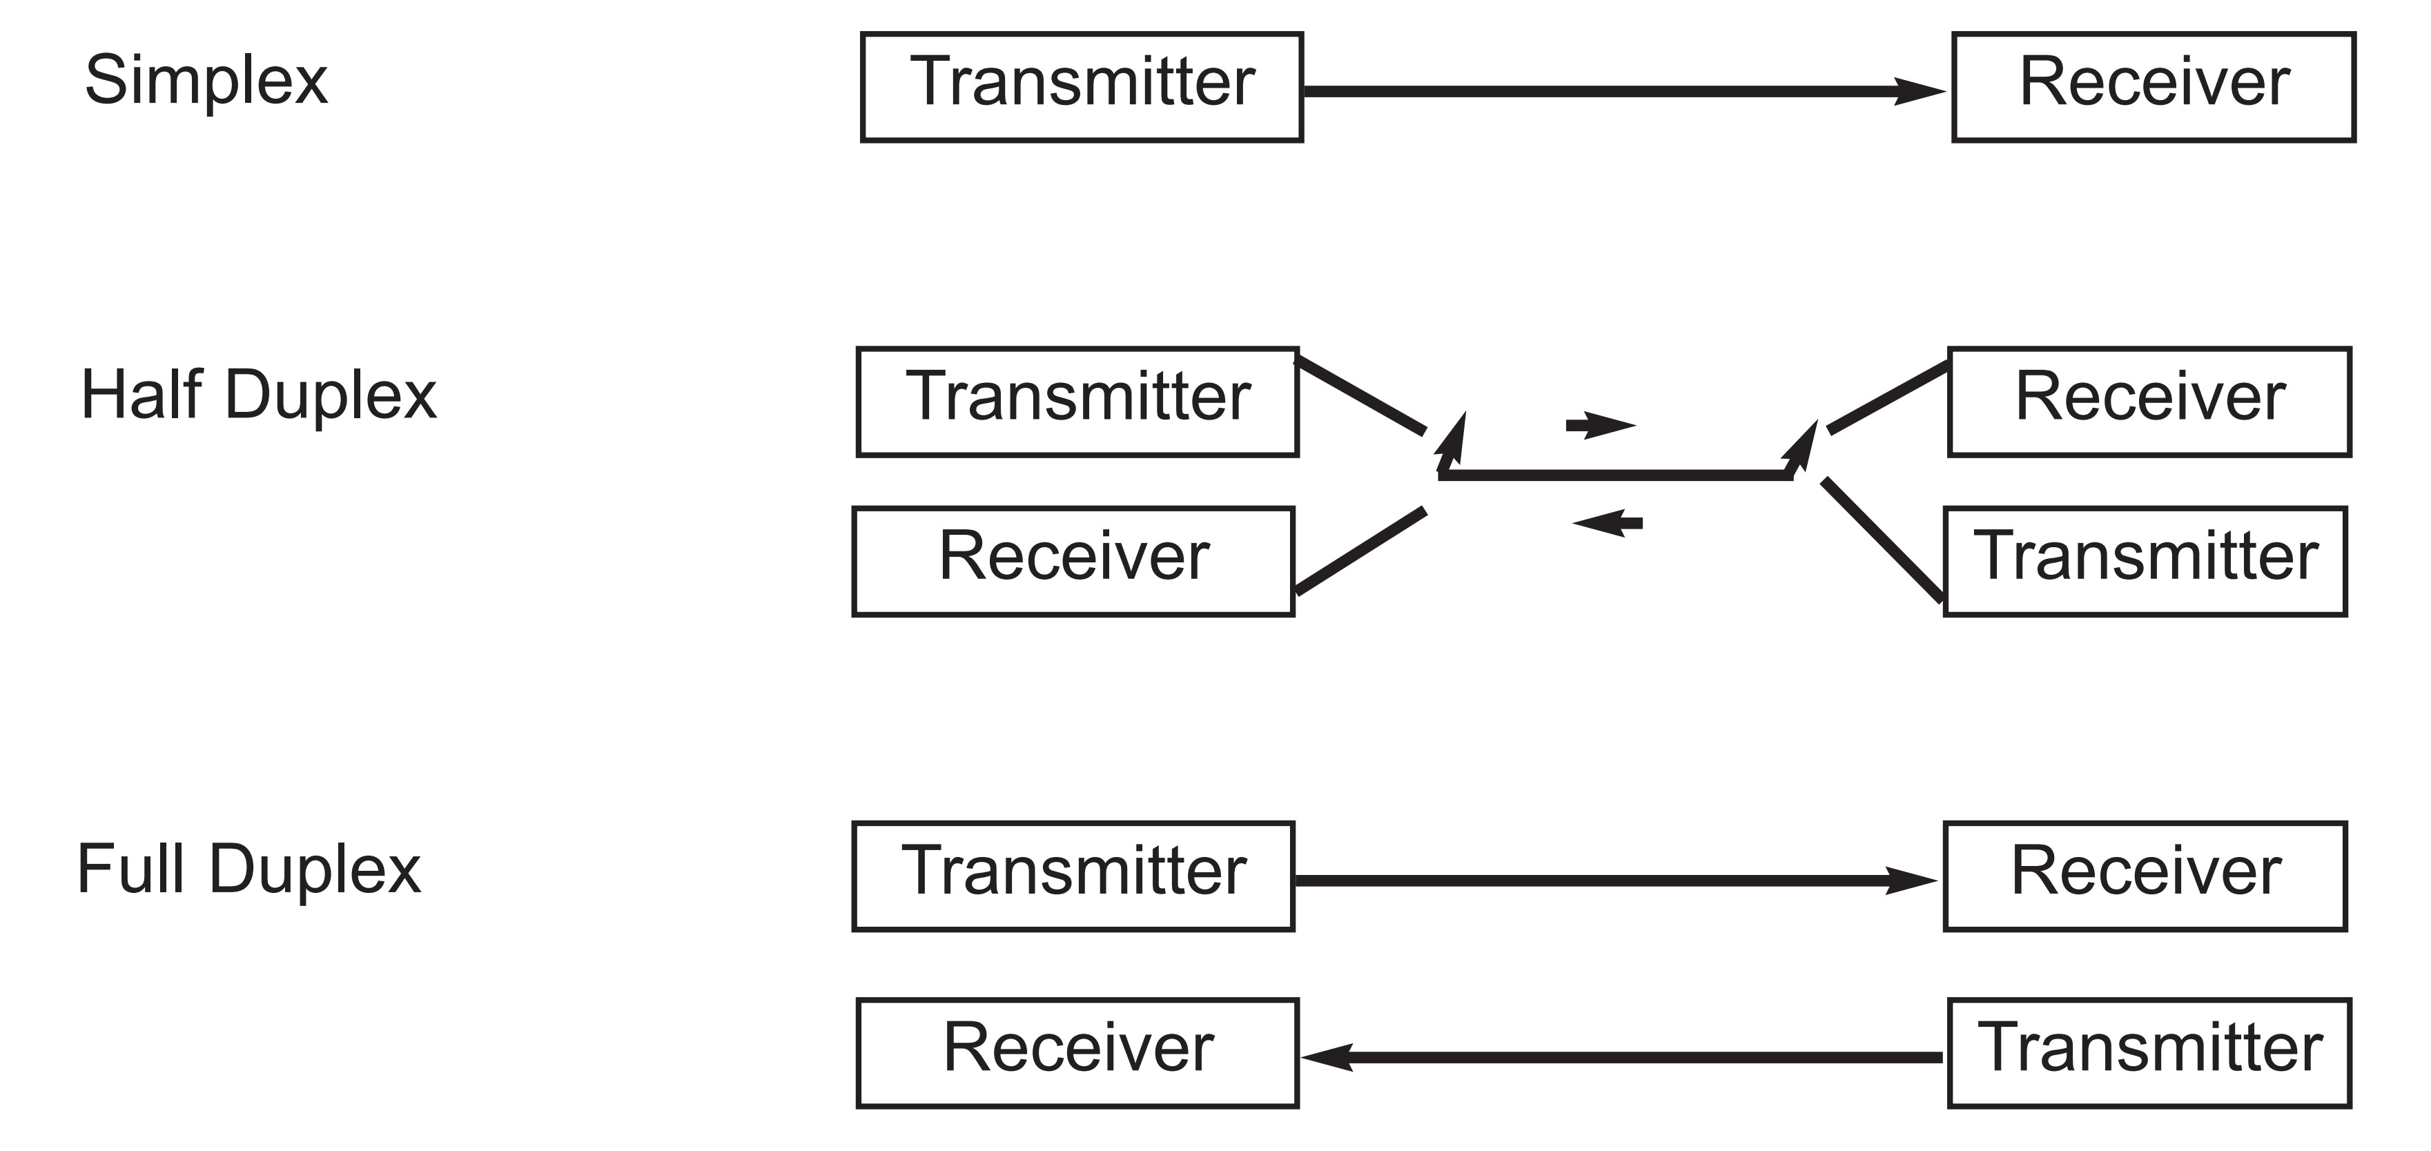
Figure 10-2. Simplex, Half-, and Full-Duplex Transfers

Slide 7
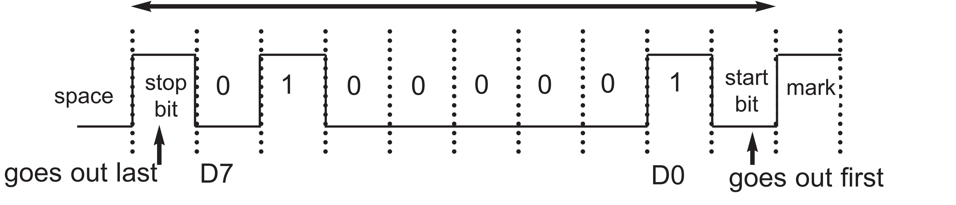
Figure 10-3. Framing ASCII “A” (41H)

Slide 8
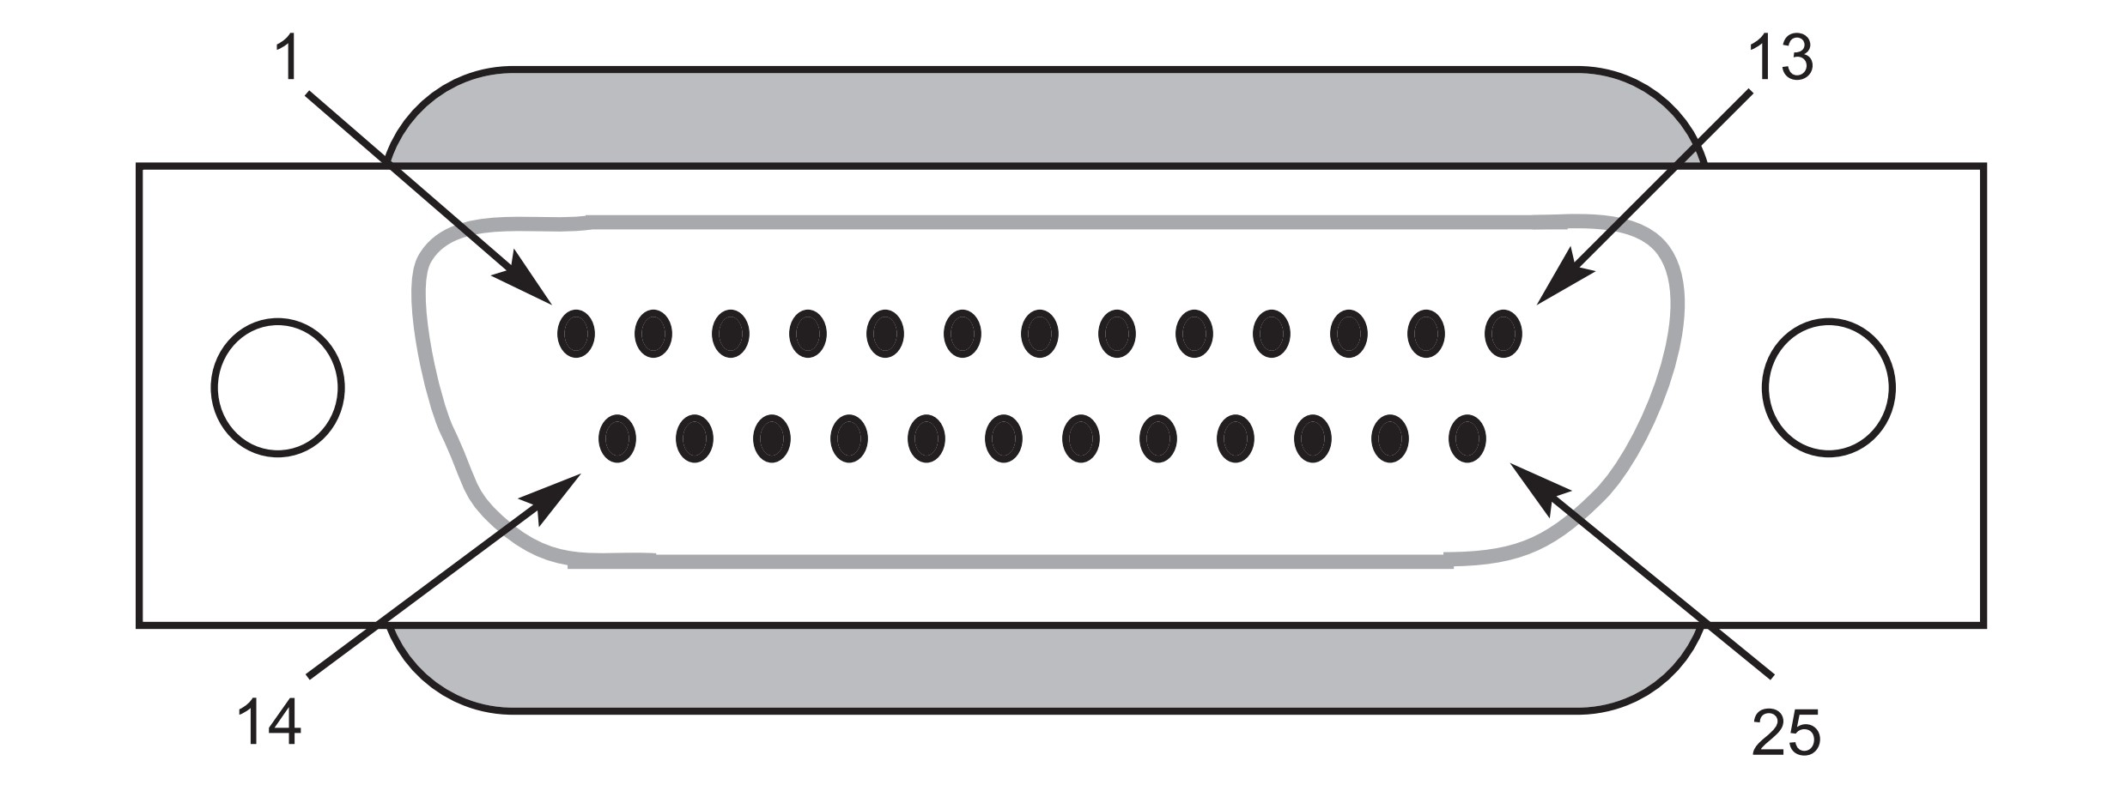
Figure 10-4. The original RS232 Connector DB-25 (No longer in use)

Slide 9
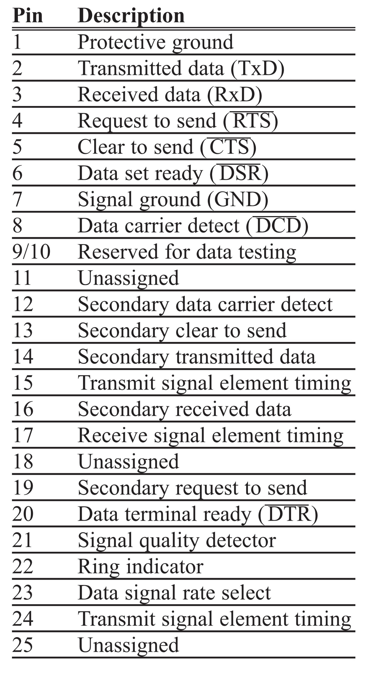
Table 10-1: RS232 Pins (DB-25)

Slide 10
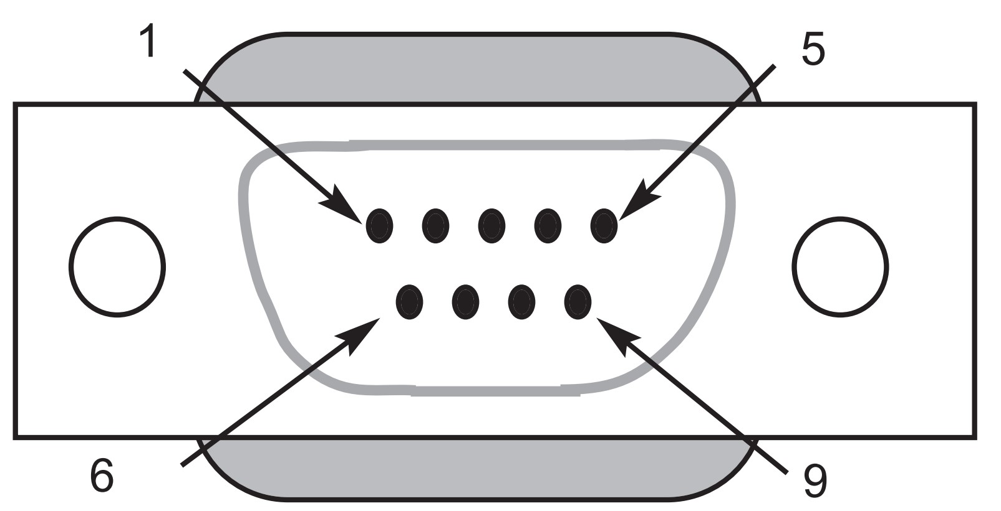
Figure 10-5. DB-9 9-Pin Connector

Slide 11
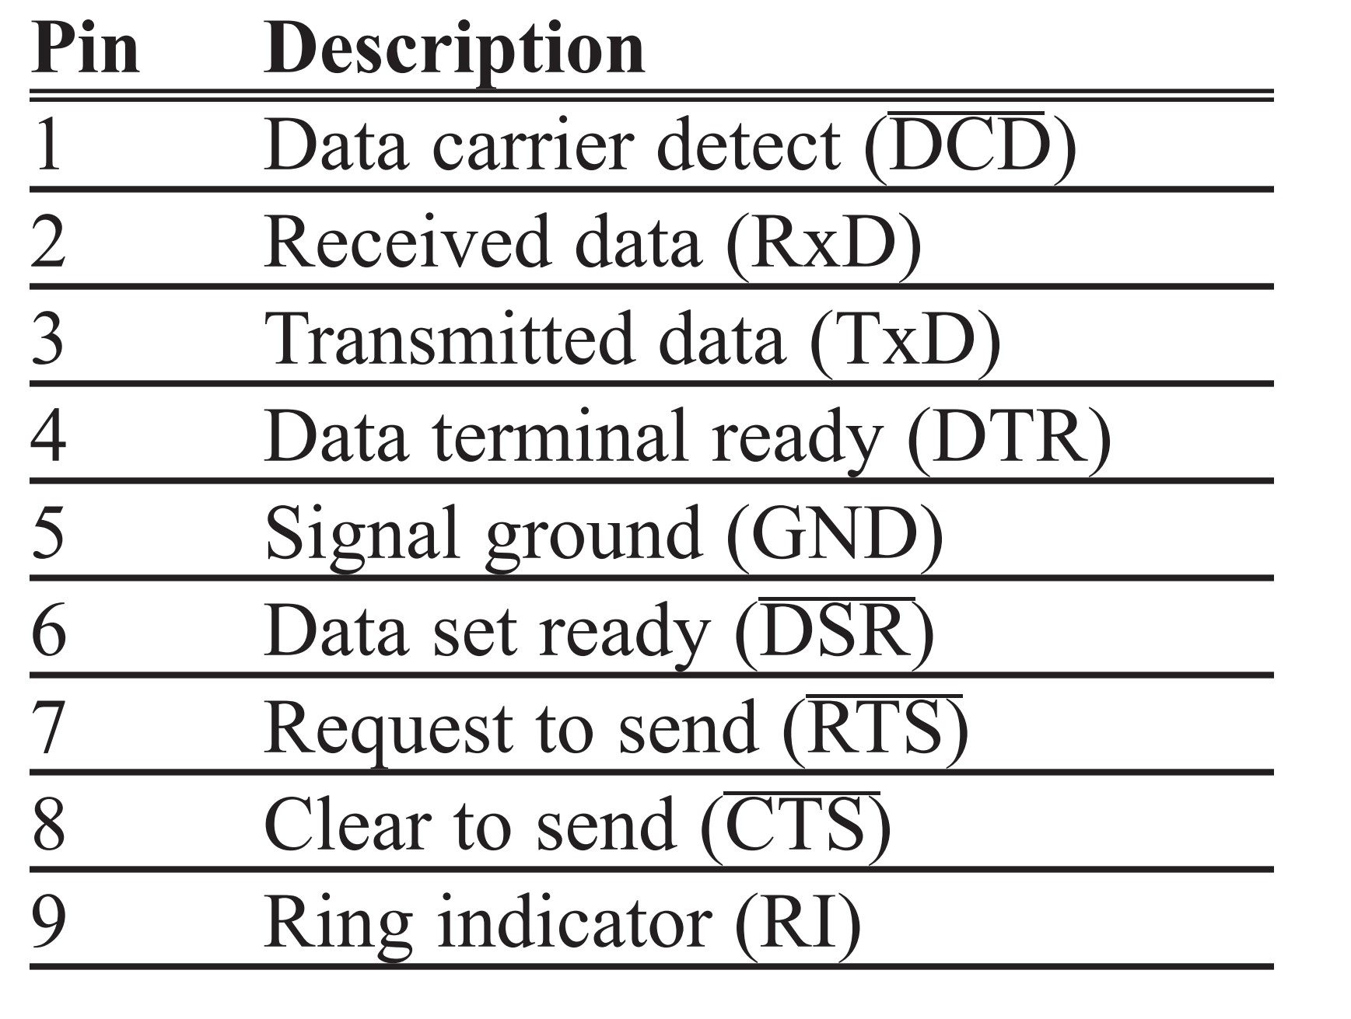
Table 10-2: IBM PC DB-9 Signals

Slide 12
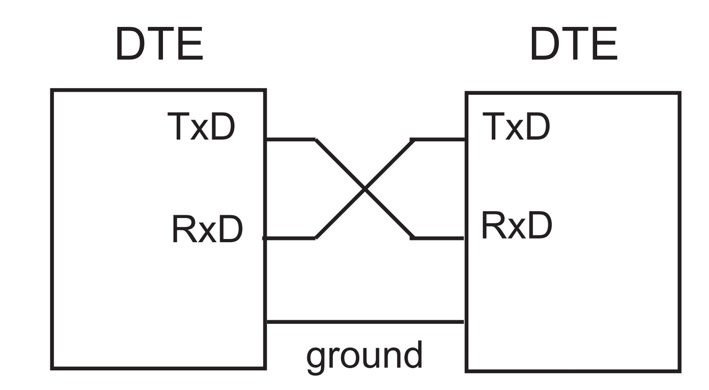
Figure 10-6. Null Modem Connection

Slide 13
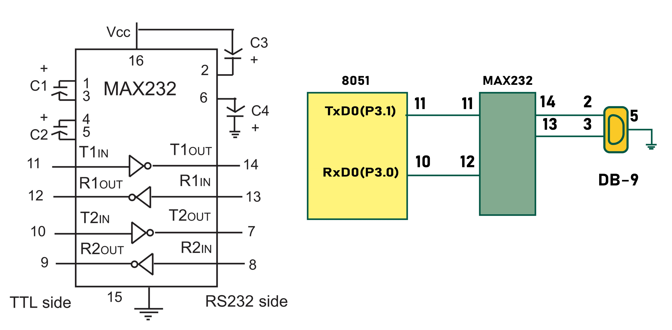
Figure 10-7. (a) Inside MAX232 and (b) its Connection to the 8051 (Null Modem)

Slide 14
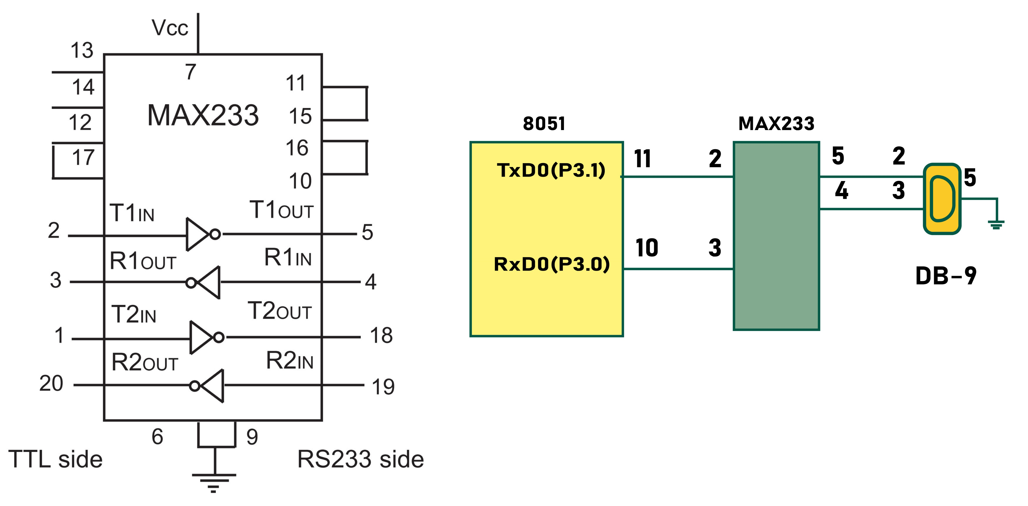
Figure 10-8. (a) Inside MAX233 and (b) Its Connection to the 8051 (Null Modem)

Slide 15
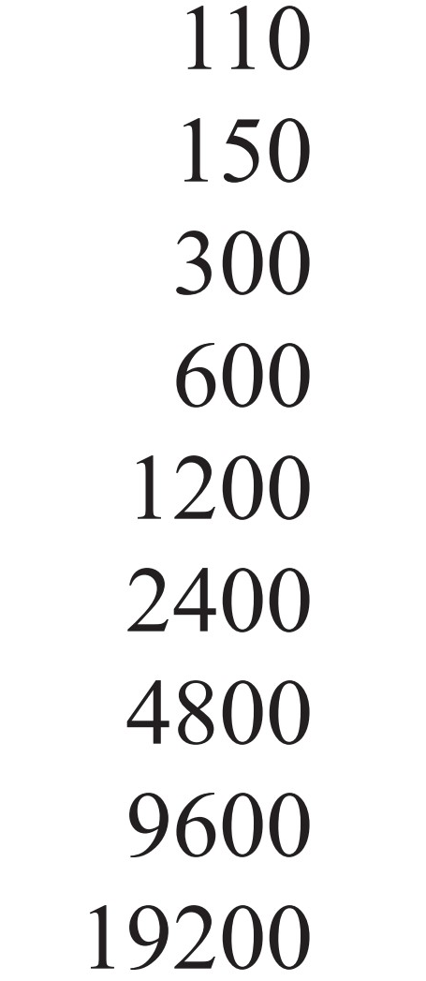
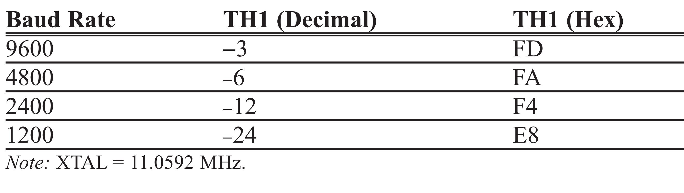
Note: Some of the Baud rates supported by x86 PC BIOS.
Table 10-3: PC Baud Rates
Table 10-4: Timer 1 TH1 Register Values for Various Baud Rates

Slide 16
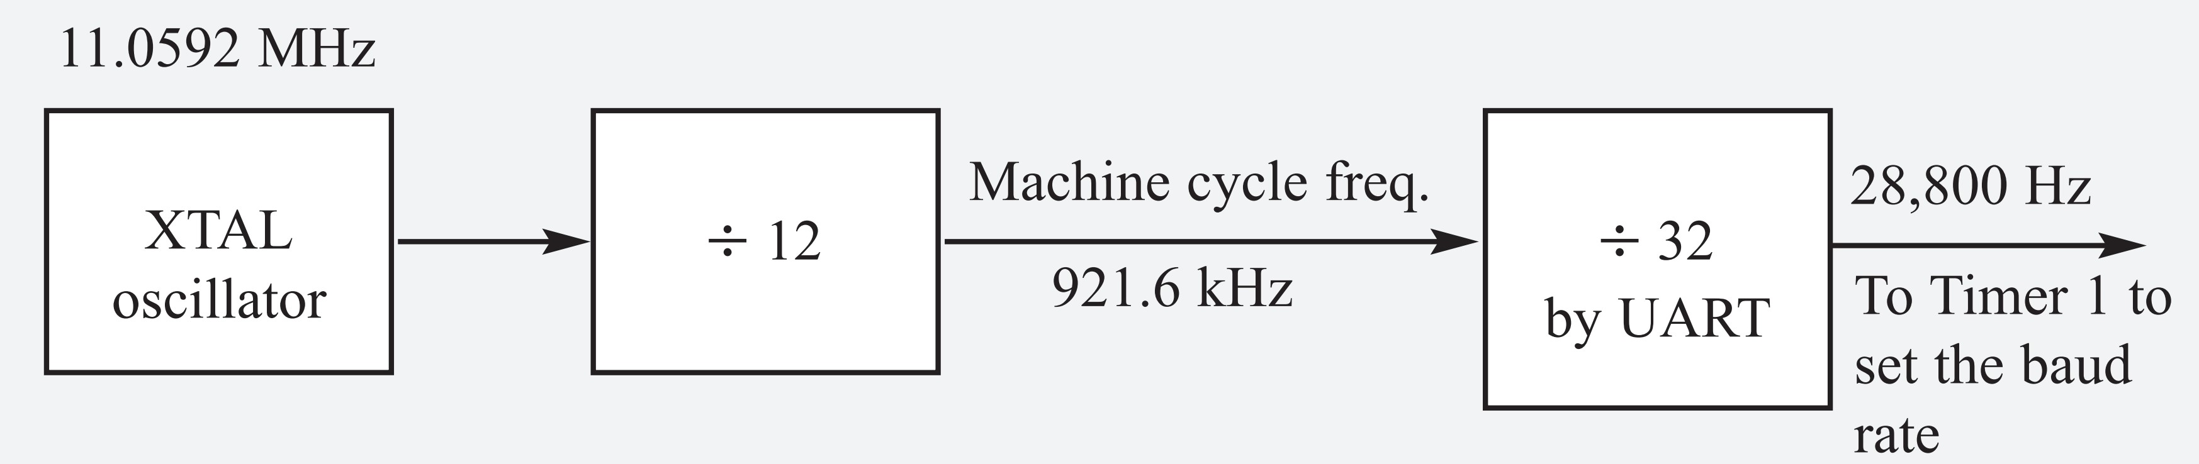
Example 10-1
With XTAL = 11.0592 MHz, find the TH1 value needed to have the following baud rates.
(a) 9600 (b) 2400 (c) 1200
Solution:
With XTAL = 11.0592 MHz, we have:
The machine cycle frequency of the 8051 = 11.0592 MHz / 12 = 921.6 kHz, and
921.6 kHz / 32 = 28,800 Hz is the frequency provided by UART to Timer 1 to set baud rate.
(a) 28,800 / 3 = 9600 where -3 = FD (hex) is loaded into TH1
(b) 28,800 / 12 = 2400 where -12 = F4 (hex) is loaded into TH1
(c) 28,800 / 24 = 1200 where -24 = E8 (hex) is loaded into TH1
Notice that 1/12th of the crystal frequency divided by 32 is the default value upon activation of the 8051 RESET pin. We can change this default setting. This is explained at the end of this chapter.

Slide 17
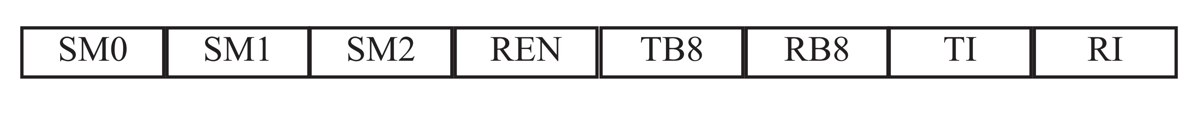
Figure 10-9. SCON Serial Port Control Register (Bit-Addressable)
SM0 SCON.7 Serial port mode specifier
SM1 SCON.6 Serial port mode specifier
SM2 SCON.5 Used for multiprocessor communication. (Make it 0.)
REN SCON.4 Set/cleared by software to enable/disable reception.
TB8 SCON.3 Not widely used.
RB8 SCON.2 Not widely used.
TI SCON.1 Transmit interrupt flag. Set by hardware at the beginning of
the stop bit in mode 1. Must be cleared by software.
RI SCON.0 Receive interrupt flag. Set by hardware halfway through the
stop bit time in mode 1. Must be cleared by software.
Note: Make SM2, TB8, and RB8 = 0.

Slide 18
Example 10-2
Write a program for the 8051 to transfer letter “A” serially at 4800 baud, continuously.
Solution:
MOV TMOD,#20H ;Timer 1, mode 2(auto-reload)
MOV TH1,#-6 ;4800 baud rate
MOV SCON,#50H ;8-bit, 1 stop, REN enabled
SETB TR1 ;start Timer 1
AGAIN: MOV SBUF,#"A" ;letter "A" to be transferred
HERE: JNB TI,HERE ;wait for the last bit
CLR TI ;clear TI for next char
SJMP AGAIN ;keep sending A

Slide 19
Example 10-3
Write a program to transfer the message “YES” serially at 9600 baud, 8-bit data, 1 stop bit. Do this continuously.
Solution:
MOV TMOD,#20H ;Timer 1, mode 2
MOV TH1,#-3 ;9600 baud
MOV SCON,#50H ;8-bit, 1 stop bit, REN enabled
SETB TR1 ;start Timer 1
AGAIN: MOV A,#"Y" ;transfer "Y"
ACALL TRANS
MOV A,#"E" ;transfer "E"
ACALL TRANS
MOV A,#"S" ;transfer "S"
ACALL TRANS
SJMP AGAIN ;keep doing it
;-----serial data transfer subroutine
TRANS: MOV SBUF,A ;load SBUF
HERE: JNB TI,HERE ;wait for last bit to transfer
CLR TI ;get ready for next byte
RET

Slide 20
Example 10-4
Program the 8051 to receive bytes of data serially, and put them in P1. Set the baud rate at 4800, 8-bit data, and 1 stop bit.
Solution:
MOV TMOD,#20H ;Timer 1, mode 2(auto-reload)
MOV TH1,#-6 ;4800 baud
MOV SCON,#50H ;8-bit, 1 stop, REN enabled
SETB TR1 ;start Timer 1
HERE: JNB RI,HERE ;wait for char to come in
MOV A,SBUF ;save incoming byte in A
MOV P1,A ;send to port 1
CLR RI ;get ready to receive next byte
SJMP HERE ;keep getting data

Slide 21
Example 10-5
Assume that the 8051 serial port is connected to the COM port of the IBM PC, and on the PC we are using the HyperTerminal program to send and receive data serially. P1 and P2 of the 8051 are connected to LEDs and switches, respectively. Write an 8051 program to (a) send to the PC the message “We Are Ready”, (b) receive any data sent by the PC and put it on LEDs connected to P1, and (c) get data on switches connected to P2 and send it to the PC serially. The program should perform part (a) once, but parts (b) and (c) continuously. Use the 4800 baud rate.

Slide 22
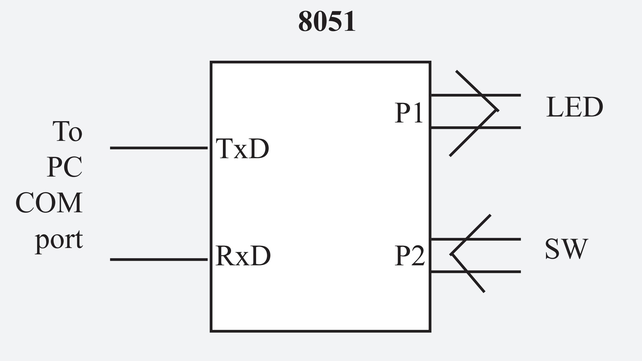
ORG 0
MOV P2,#0FFH ;make P2 an input port
MOV TMOD,#20H ;Timer 1, mode 2(auto-reload)
MOV TH1,#0FAH ;4800 baud rate
MOV SCON,#50H ;8-bit,1 stop, REN enabled
SETB TR1 ;start Timer 1
MOV DPTR,#MYDATA ;load pointer for message
H_1: CLR A
MOVC A,@A+DPTR ;get the character
JZ B_1 ;if last character get out
ACALL SEND ;otherwise call transfer
INC DPTR ;next one
SJMP H_1 ;stay in loop
B_1: MOV A,P2 ;read data on P2
ACALL SEND ;transfer it serially
ACALL RECV ;get the serial data
MOV P1,A ;display it on LEDs
SJMP B_1 ;stay in loop indefinitely
;--------------serial data transfer. ACC has the data
SEND: MOV SBUF,A ;load the data
H_2: JNB TI,H_2 ;stay here until last bit gone
CLR TI ;get ready for next char
RET ;return to caller
;----------------receive data serially in ACC
RECV: JNB RI,RECV ;wait here for char
MOV A,SBUF ;save it in ACC
CLR RI ;get ready for next char
RET ;return to caller
;-----------------The message
MYDATA: DB "We Are Ready",0
END
Example 10-5
Solution:

Slide 23
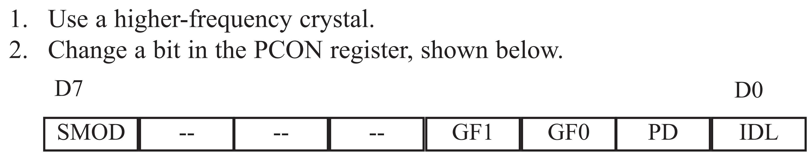
Doubling the Baud Rate in the 8051

Slide 24
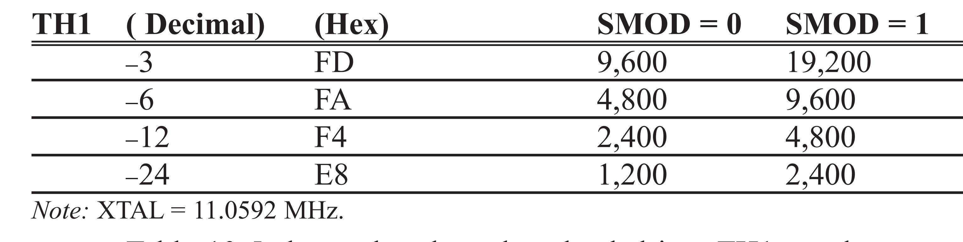
Table 10-5: Baud Rate Comparison for SMOD = 0 and SMOD = 1

Slide 25
Example 10-6
Assuming that XTAL = 11.0592 MHz for the following program, state (a) what this program does, (b) compute the frequency used by Timer 1 to set the baud rate, and (c) find the baud rate of the data transfer.
MOV A,PCON ;A = PCON
SETB ACC.7 ;make D7 = 1
MOV PCON,A ;SMOD = 1, double baud rate
;with same XTAL freq.
MOV TMOD,#20H ;Timer 1, mode 2(auto-reload)
MOV TH1,-3 ;19200 (57,600 / 3 = 19200 baud rate
;since SMOD=1)
MOV SCON,#50H ;8-bit data,1 stop bit, RI enabled
SETB TR1 ;start Timer 1
MOV A,#"B" ;transfer letter B
A_1: CLR TI ;make sure TI=0
MOV SBUF,A ;transfer it
H_1: JNB TI H_1 ;stay here until the last bit is gone
SJMP A_1 ;keep sending "B" again and again

Slide 26
Example 10-6
Solution:
(a) This program transfers ASCII letter B (01000010 binary) continuously.
(b) With XTAL = 11.0592 MHz and SMOD = 1 in the above program, we have:
11.0592 MHz / 12 = 921.6 kHz machine cycle frequency
921.6 kHz / 16 = 57,600 Hz frequency used by Timer 1 to set the baud rate
57,600 Hz / 3 = 19,200 baud rate

Slide 27
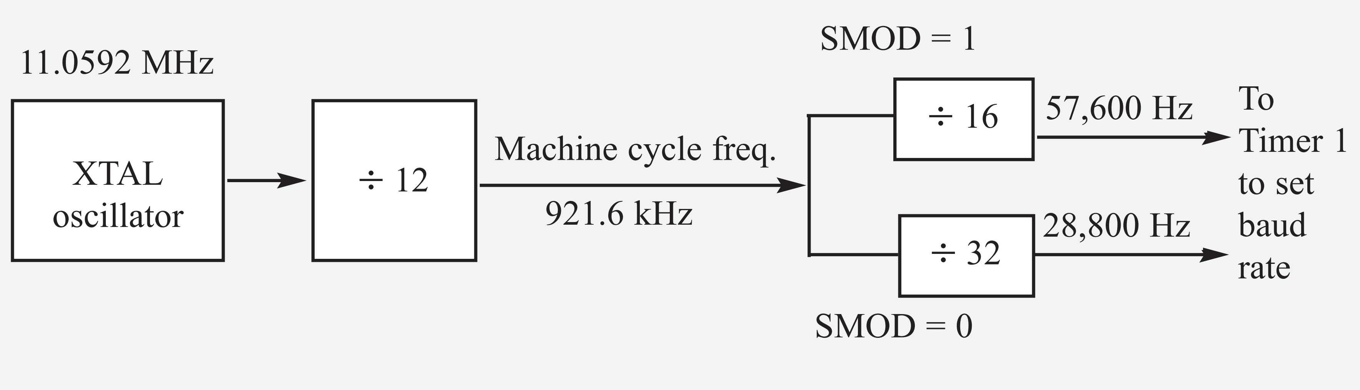
Example 10-7
Find the TH1 value (in both decimal and hex) to set the baud rate to each of the following. (a) 9600 (b) 4800 if SMOD = 1 Assume that XTAL = 11.0592 MHz.
Solution:
With XTAL = 11.0592 MHz and SMOD = 1, we have Timer 1 frequency = 57,600 Hz.
(a) 57,600 / 9600 = 6; therefore, TH1 = -6 or TH1 = FAH.
(b) 57,600 / 4800 = 12; therefore, TH1 = -12 or TH1 = F4H.

Slide 28
Example 10-8
Find the baud rate if TH1 = -2, SMOD = 1, and XTAL = 11.0592 MHz. Is this baud rate supported by IBM/compatible PCs?
Solution:
With XTAL = 11.0592 MHz and SMOD = 1, we have Timer 1 frequency = 57,600 Hz. The baud rate is 57,600 / 2 = 28,800. This baud rate is not supported by the BIOS of the PCs; however, the PC can be programmed to do data transfer at such a speed. Also, HyperTerminal in Windows supports this and other baud rates.

Slide 29
Assume a switch is connected to pin P1.7. Write a program to monitor its status and send two messages to serial port continuously as follows: SW=0 send “NO” SW=1 send “YES”
Assume XTAL = 11.0592 MHz, 9600 baud, 8-bit data, and 1 stop bit.
Example 10-9
Solution:
SW1 EQU P1.7
ORG 0H ;starting position
MAIN: MOV TMOD,#20H
MOV TH1,#-3 ;9600 baud rate
MOV SCON,#50H
SETB TR1 ;start timer
SETB SW1 ;make SW an input
S1: JB SW1,NEXT ;check SW status
MOV DPTR,#MESS1 ;if SW=0 display "NO"
FN: CLR A
MOVC A,@A+DPTR ;read the value
JZ S1 ;check for end of line
ACALL SENDCOM ;send value to serial port
INC DPTR ;move to next value
SJMP FN ;repeat
NEXT: MOV DPTR,#MESS2 ;if SW=1 display "YES"
LN: CLR A
MOVC A,@A+DPTR ;read the value
JZ S1 ;check for end of line
ACALL SENDCOM ;send value to serial port
INC DPTR ;move to next value
SJMP LN ;repeat
;------------------
SENDCOM: MOV SBUF,A ;place value in buffer
HERE: JNB TI,HERE ;wait until transmitted
CLR TI ;clear
RET ;return
;------------------
MESS1: DB "NO",0
MESS2: DB "YES",0
END

Slide 30
Write a program to send the message “The Earth is but One Country” to serial port. Assume a SW is connected to pin P1.2. Monitor its status and set the baud rate as follows: SW = 0, 4800 baud rate
SW = 1, 9600 baud rate Assume XTAL = 11.0592 MHz, 8-bit data, and 1 stop bit.
Example 10-10
Solution:
SW BIT P1.2
ORG 0H ;Starting position
MAIN: MOV TMOD,#20H
MOV TH1,#-6 ;4800 baud rate (default)
MOV SCON,#50H
SETB TR1
SETB SW ;make SW an input
S1: JNB SW,SLOWSP ;check SW status
MOV A,PCON ;read PCON
SETB ACC.7 ;set SMOD High for 9600
MOV PCON,A ;write PCON
SJMP OVER ;send message
SLOWSP: MOV A,PCON ;read PCON
CLR ACC.7 ;make SMOD Low for 4800
MOV PCON,A ;write PCON
OVER: MOV DPTR,#MESS1 ;load address to message
FN: CLR A
MOVC A,@A+DPTR ;read value
JZ S1 ;check for end of line
ACALL SENDCOM ;send value to the serial port
INC DPTR ;move to next value
SJMP FN ;repeat
;-------------
SENDCOM:
MOV SBUF,A ;place value in buffer
HERE: JNB TI,HERE ;wait until transmitted
CLR TI ;clear
RET ;return
;------------------
MESS1: DB "The Earth is but One Country",0
END

Slide 31
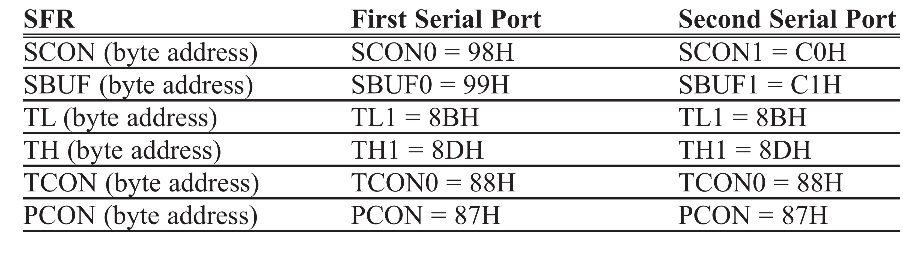
Table 10-6: SFR Byte Addresses for DS89C4x0 Serial Ports

Slide 32
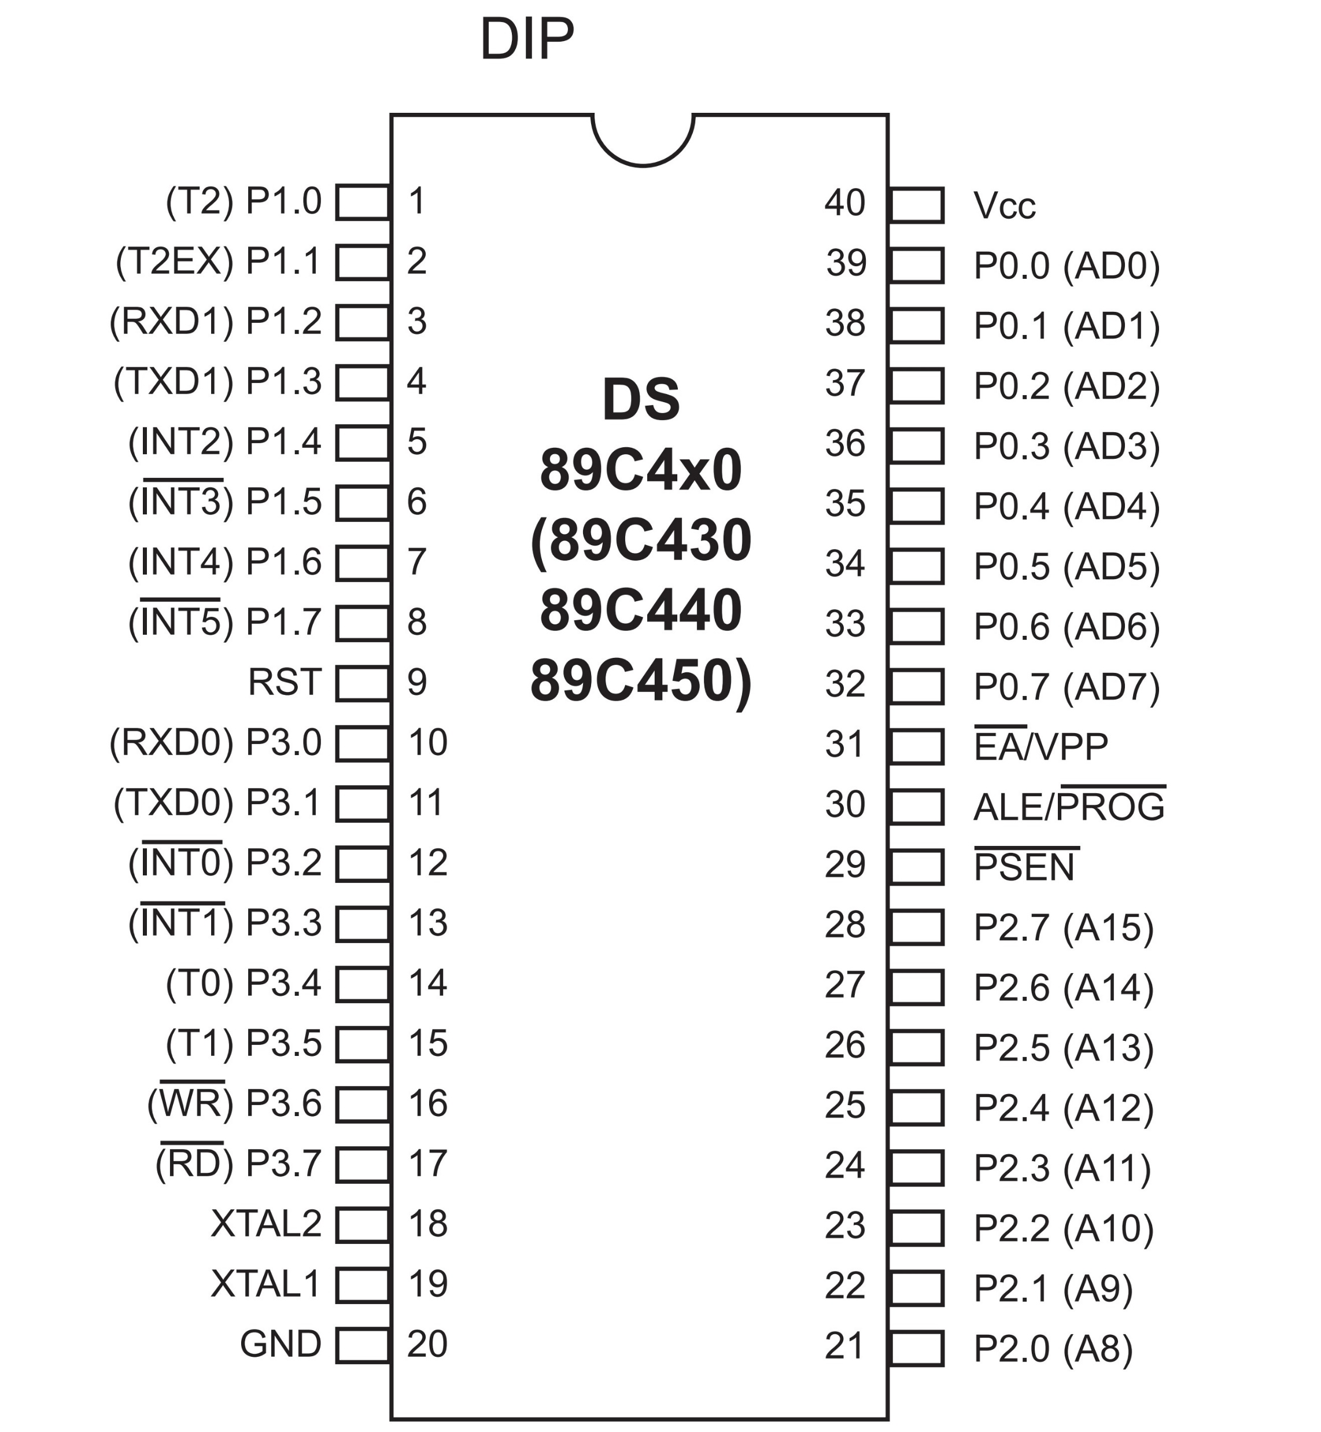
Figure 10-10. DS89C4x0 Pin Diagram
Note: Notice P1.2 and P1.3 pins are used by Rx and Tx lines of the 2nd serial port

Slide 33
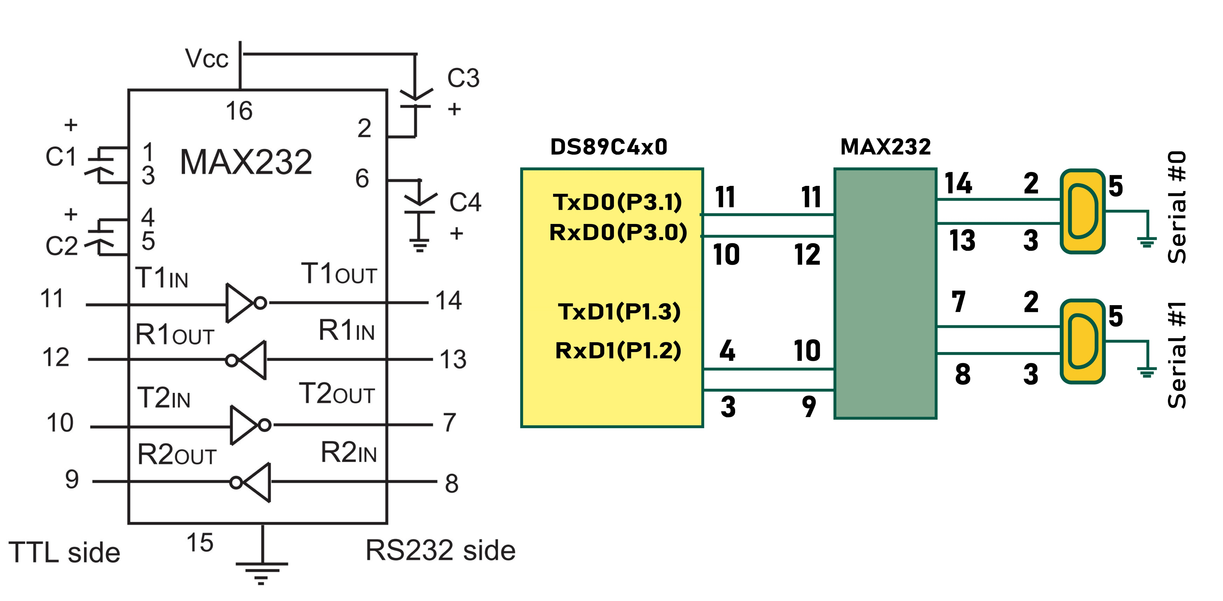
Figure 10-11. (a) Inside MAX232 and (b) its Connection to the DS89C4x0

Slide 34
Symbol Name Address
ACC* Accumulator E0H
B* B register F0H
PSW* Program status word D0H
SP Stack pointer 81H
DPTR Data pointer 2 bytes
DPL Low byte 82H
DPH High byte 83H
P0* Port 0 80H
P1* Port 1 90H
P2* Port 2 0A0H
P3* Port 3 B0H
IP* Interrupt priority control B8H
IE* Interrupt enable control A8H
TMOD Timer/counter mode control 89H
TCON* Timer/counter control 88H
T2CON* Timer/counter 2 control C8H
T2MOD Timer/counter mode control C9H
TH0 Timer/counter 0 high byte 8CH
TL0 Timer/counter 0 low byte 8AH
TH1 Timer/counter 1 high byte 8DH
TL1 Timer/counter 1 low byte 8BH
TH2 Timer/counter 2 high byte CDH
TL2 Timer/counter 2 low byte CCH
RCAP2H T/C 2 capture register high byte CBH
RCAP2L T/C 2 capture register low byte CAH
SCON0* Serial control (first serial port) 98H
SBUF0 Serial data buffer (first serial port) 99H
PCON Power control 87H
SCON1* Serial control(second serial port) C0H
SBUF1 Serial data buffer (second serial port) C1H
* Bit-addressable
Table 10-7: SFR Addresses for the DS89C4x0

Slide 35
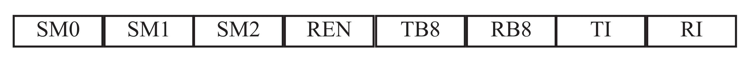
Figure 10-12. SCON0 and SCON1 Bit Addresses (TI and RI bits must be noted)
Bits Bit Addresses
Serial #0 Serial #1
SM0 SCON0.7 = 9FH SCON1.7 = C7H Serial port mode specifier
SM1 SCON0.6 = 9EH SCON1.6 = C6H Serial port mode specifier
SM2 SCON0.5 = 9DH SCON1.5 = C5H Multiprocessor com.
REN SCON0.4 = 9CH SCON1.4 = C4H Enable/disable reception
TB8 SCON0.3 = 9BH SCON1.3 = C3H Not widely used
RB8 SCON0.2 = 9AH SCON1.2 = C2H Not widely used
TI SCON0.1 = 99H SCON1.1 = C1H Transmit interrupt flag
RI SCON0.0 = 98H SCON1.0 = C0H Receive interrupt flag
Note: Make SM2, TB8, and RB8 = 0.

Slide 36
Write a program for the second serial port of the DS89C4x0 to continuously transfer the letter “A” serially at 4800 baud. Use 8-bit data and 1 stop bit. Use Timer 1.
Example 10-11
Solution:
SBUF1 EQU 0C1H ;second serial SBUF addr
SCON1 EQU 0C0H ;second serial SCON addr
TI1 BIT 0C1H ;second serial TI bit addr
RI1 BIT 0C0H ;second serial RI bit addr
ORG 0H ;starting position
MAIN:
MOV TMOD,#20H ;COM2 uses Timer 1 upon reset
MOV TH1,#-6 ;4800 baud rate
MOV SCON1,#50H ;COM2 has its own SCON1
SETB TR1 ;start Timer 1
AGAIN: MOV A,#'A' ;send char 'A'
ACALL SENDCOM2
SJMP AGAIN
;-------------
SENDCOM2:
MOV SBUF1,A ;COM2 has its own SBUF
HERE: JNB TI1,HERE ;COM2 has its own TI flag
CLR TI1
RET
END

Slide 37
Write a program to send the text string “Hello” to Serial #1. Set the baud rate at 9600, 8-bit data, and 1 stop bit.
Example 10-12
Solution:
SCON1 EQU 0C0H
SBUF1 EQU 0C1H
TI1 BIT 0C1H
ORG 0H ;starting position
MOV TMOD,#20H
MOV TH1,#-3 ;9600 baud rate
MOV SCON1,#50H
SETB TR1
MOV DPTR,#MESS1 ;display “Hello”
FN: CLR A
MOVC A,@A+DPTR ;read value
JZ S1 ;check for end of line
ACALL SENDCOM2 ;send to serial port
INC DPTR ;move to next value
SJMP FN
S1: SJMP S1
SENDCOM2:
MOV SBUF1,A ;place value in buffer
HERE1: JNB TI1,HERE1 ;wait until transmitted
CLR TI1 ;clear
RET
MESS1: DB "Hello",0
END

Slide 38
Program the second serial port of the DS89C4x0 to receive bytes of data serially and put them on P1. Set the baud rate at 4800, 8-bit data, and 1 stop bit.
Example 10-13
Solution:
SBUF1 EQU 0C1H ;second serial SBUF addr
SCON1 EQU 0C0H ;second serial SCON addr
RI1 BIT 0C0H ;second serial RI bit addr
ORG 0H ;starting position
MOV TMOD,#20H ;COM2 uses Timer 1 upon reset
MOV TH1,#-6 ;4800 baud rate
MOV SCON1,#50H ;COM2 has its own SCON1
SETB TR1 ;start Timer 1
HERE: JNB RI1,HERE ;wait for data to come in
MOV A,SBUF1 ;save data
MOV P1,A ;display on P1
CLR RI1
SJMP HERE
END

Slide 39
SCON1 EQU 0C0H
TI1 BIT 0C1H
SW1 BIT P2.0
ORG 0H ;starting position
MOV TMOD,#20H
MOV TH1,#-3 ;9600 baud rate
MOV SCON,#50H
MOV SCON1,#50H
SETB TR1
SETB SW1 ;make SW1 an input
S1: JB SW1,NEXT ;check SW1 status
MOV DPTR,#MESS1 ;if SW1=0 display “Hello”
FN: CLR A
MOVC A,@A+DPTR ;read value
JZ S1 ;check for end of line
ACALL SENDCOM1 ;send to serial port
INC DPTR ;move to next value
SJMP FN
NEXT: MOV DPTR,#MESS2 ;if SW1=1 display “Goodbye”
LN: CLR A
MOVC A,@A+DPTR ;read value
JZ S1 ;check for end of line
ACALL SENDCOM2 ;send to serial port
INC DPTR ;move to next value
SJMP LN
SENDCOM1:
MOV SBUF,A ;place value in buffer
HERE: JNB TI,HERE ;wait until transmitted
CLR TI ;clear
RET
SENDCOM2:
MOV SBUF1,A ;place value in buffer
HERE1: JNB TI1,HERE1 ;wait until transmitted
CLR TI1 ;clear
RET
MESS1: DB "Hello",0
MESS2: DB "Goodbye",0
END
Example 10-14
Solution:
Assume that a switch is connected to pin P2.0. Write a program to monitor the switch and perform the following:
If SW = 0 send the message “Hello” to the Serial #0 port.
(b) If SW = 1 send the message “Goodbye” to the Serial #1 port.

Slide 40
Example 10-15
Write a C program for the 8051 to transfer the letter “A” serially at 4800 baud continuously. Use 8-bit data and 1 stop bit.
Solution:
#include <reg51.h>
void main(void)
{
TMOD=0x20; //use Timer 1,8-BIT auto-reload
TH1=0xFA; //4800 baud rate
SCON=0x50;
TR1=1;
while(1)
{
SBUF='A'; //place value in buffer
while(TI==0);
TI=0;
}
}

Slide 41
Example 10-16
Write an 8051 C program to transfer the message “YES” serially at 9600 baud, 8-bit data, 1 stop bit. Do this continuously.
Solution:
#include <reg51.h>
void SerTx(unsigned char);
void main(void)
{
TMOD=0x20; //use Timer 1,8-BIT auto-reload
TH1=0xFD; //9600 baud rate
SCON=0x50;
TR1=1; //start timer
while(1)
{
SerTx('Y');
SerTx('E');
SerTx('S');
}
}
void SerTx(unsigned char x)
{
SBUF=x; //place value in buffer
while(TI==0); //wait until transmitted
TI=0;
}

Slide 42
Example 10-17
Program the 8051 in C to receive bytes of data serially and put them in P1. Set the baud rate at 4800, 8-bit data, and 1 stop bit.
Solution:
#include <reg51.h>
void main (void)
{
unsigned char mybyte;
TMOD=0x20; //use Timer 1,8-BIT auto-reload
TH1=0xFA; //4800 baud rate
SCON=0x50;
TR1=1; //start timer
while(1) //repeat forever
{
while(RI==0); //wait to receive
mybyte=SBUF; //save value
P1=mybyte; //write value to port
RI=0;
}
}

Slide 43
Example 10-18
Solution:
#include <reg51.h>
sbit MYSW=P2^0; //input switch
void main(void)
{
unsigned char z;
unsigned char fname[]="ALI";
unsigned char lname[]="SMITH";
TMOD=0x20; //use Timer 1,8-BIT auto-reload
TH1=0xFD; //9600 baud rate
SCON=0x50;
TR1=1; //start timer
if(MYSW==0) //check switch
{
for(z=0;z<3;z++) //write name
{
SBUF=fname[z]; //place value in buffer
while(TI==0); //wait for transmit
TI=0;
}
}
else
{
for(z=0;z<5;z++) //write name
{
SBUF=lname[z]; //place value in buffer
while(TI==0); //wait for transmit
TI=0;
}
}
}
Write an 8051 C program to send two different strings to the serial port. Assuming that SW is connected to pin P2.0, monitor its status and make a decision as follows:
SW = 0: send your first name
SW = 1: send your last name
Assume XTAL = 11.0592 MHz, baud rate of 9600, 8-bit data, 1 stop bit.

Slide 44
Example 10-19
Solution:
#include <reg51.h>
sbit MYSW=P2^0; //input switch
void main(void)
{
unsigned char z;
unsigned char Mess1[]="Normal Speed";
unsigned char Mess2[]="High Speed";
TMOD=0x20; //use Timer 1,8-BIT auto-reload
TH1=0xFF; //28,800 for normal speed
SCON=0x50;
TR1=1; //start timer
if(MYSW==0)
{
for(z=0;z<12;z++)
{
SBUF=Mess1[z]; //place value in buffer
while(TI==0); //wait for transmit
TI=0;
}
}
else
{
PCON=PCON|0x80; //for high speed of 56K
for(z=0;z<10;z++)
{
SBUF=Mess2[z]; //place value in buffer
while(TI==0); //wait for transmit
TI=0;
}
}
}
Write an 8051 C program to send the two messages “Normal Speed” and “High Speed” to the serial port. Assuming that SW is connected to pin P2.0, monitor its status and set the baud rate as follows:
SW = 0 28,800 baud rate
SW = 1 56K baud rate
Assume that XTAL = 11.0592 MHz for both cases.

Slide 45
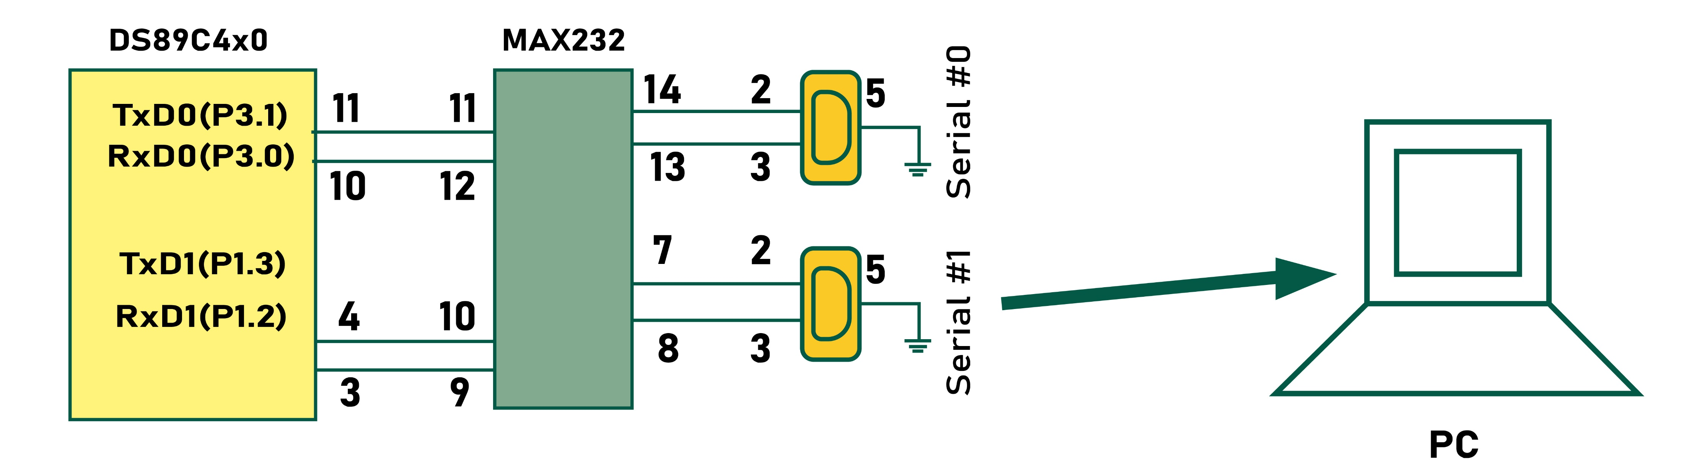
Write a C program for the DS89C4x0 to transfer letter “A” serially at 4800 baud continuously. Use the second serial port with 8-bit data and 1 stop bit.
We can only use Timer 1 to set the baud rate.
Example 10-20
Solution:
#include <reg51.h>
sfr SBUF1=0xC1;
sfr SCON1=0xC0;
sbit TI1=0xC1;
void main(void)
{
TMOD=0x20; //use Timer 1 for 2nd serial port
TH1=0xFA; //4800 baud rate
SCON1=0x50; //use 2nd serial port SCON1 register
TR1=1; //start timer
while(1)
{
SBUF1='A'; //use 2nd serial port SBUF1 register
while(TI1==0); //wait for transmit
TI1=0;
}
}

Slide 46
Example 10-21
Program the DS89C4x0 in C to receive bytes of data serially via the second serial port and put them in P1. Set the baud rate at 9600, 8-bit data, and 1 stop bit. Use Timer 1 for baud rate generation.
Solution:
#include <reg51.h>
sfr SBUF1=0xC1;
sfr SCON1=0xC0;
sbit RI1=0xC0;
void main(void)
{
unsigned char mybyte;
TMOD=0x20; //use Timer 1,8-BIT auto-reload
TH1=0xFD; //9600
SCON1=0x50; //use SCON1 of 2nd serial port
TR1=1;
while(1)
{
while(RI1==0); //monitor RI1 of 2nd serial port
mybyte=SBUF1; //use SBUF1 of 2nd serial port
P2=mybyte; //place value on port
RI1=0;
}
}

